Slide 1

#Introduction to Shodan.io Sagar Chhatrala @sschhatrala

Slide 2
Disclaimer ____________________________________
Views, Thoughts and Opinions expressed in this presentation are my own and are not endorsed by my employer.

Slide 3
Outline ____________________________________
What is shodan.io
How does it work ?
Banner
Database / Metadata
Default search includes
Shodan search filters
Examples
Plugins
CLI
Shutting the door on Shodan
Notes

Slide 4
What is shodan.io? ____________________________________
The search engine for The Web
The search engine for Security
The search engine for Buildings
The search engine for Web Cams
The search engine for Refrigerators
The search engine for Power plants
The search engine for The Internet of Things

Slide 5
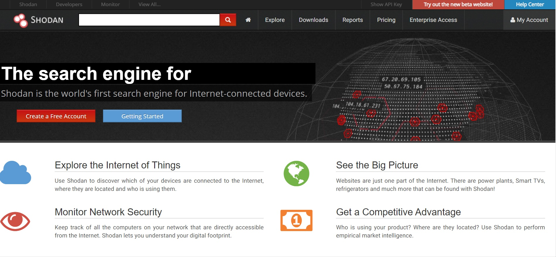

Slide 6
What is shodan ____________________________________
SHODAN = Sentient Hyper-Optimized Data Access Network
Unlike traditional search engines that crawl the web to display results, Shodan attempts to grab data from ports
Shodan is a search engine that lets you find specific information from routers, servers, and any device with an IP address.
Shodan indexes a large amount of data, which is really helpful when searching for specific devices that happen to be connected to the internet.

Slide 7
How does it work ? ____________________________________
Whenever shodan gets a query from a user, it generates randomized IPv4 addresses and
Random Ports -> retrieve Banners -> Banner Analysis / process / Logic -> Result
Shodan uses OR operator by default for filtering queries.
If you want to search for a word that include spaces or want combine two different filters, you can use +. It will work as AND operator.

Slide 8
Banner ____________________________________
What is a Banner? A banner is collection of text data that give details of a service running on a host like Content Type, Cookies, Web Server and Content-length. Banners are always different for different kind of services and keep on changing time to time. Here's an example of a banner returned in response of a request:
HTTP/1.1 200 OK Server: apache2 Date: Sun, 13 May 2018 02:12:34 GMT Content-Type: text/html; charset=utf-8 Content-Length: 9879 Connection: keep-alive

Slide 9
Database / Meta data ____________________________________
Database
Shodan databases are updated 24 hours a day and 7 days a week. So, it means anytime you search, you are retrieving the latest results on the Internet.
Meta Data
In addition to Banners, shodan crawlers also look for the meta data of an IP address and show results from the past month. Meta Data are the information collected from an IP address like its Physical location, Geo Coordinates and ISP etc.

Slide 10
Default Search includes ________________________________________
The Shodan documentation doesn't disclose exactly what protocol data is used in the default search, but empirical analysis indicates that it includes at least the following:
HTTP header information
HTTPS header and certificate information
Several gaming server banners (Steam's A2S, Minecraft, and more)
FTP banners
NetBIOS server banner
SSH header and server key data
Telnet banner
SMTP banner
NTP banner
SIP/VoIP banner
DNS server configuration settings
And more!

Slide 11
Shodan search filters ____________________________________
Format of the enterign filter is
filtername:value
Important: There is no space between the colon “:” and the value.
Here are the basic search filters you can use:
city: find devices in a particular city
country: find devices in a particular country
geo: you can pass it coordinates
hostname: find values that match the hostname
net: search based on an IP or /x CIDR
os: search based on operating system
port: find particular ports that are open
before/after: find results within a timeframe
Advanced Integration:
Metasploit shodan module
Maltego
Geolocation mapping via https://maps.shodan.io

Slide 12
Example: ____________________________________
country and city:
country:"FR" city:"paris" nginx
The above query will search for the word "nginx" in banners retreived from the IP addresses which are located in Paris, France.
IP filter:
ip:'127.0.0.1'
This will look for the banners from the IP 127.0.0.1
os, product:
product:MySQL os:windows
Now, this will search for MySQL databases running the Windows Operating System

Slide 13
Example: ____________________________________
HTTP filters
Besides, the general filters, shodan also provides some http filters. These filters are to fetch some of the important details from within the document like document title, technologies used. General used Shodan filters are:
http.component: value must be the name of technologies used like wordpress, JQuerey, Drupal, Django etc.
http.title: Title for the website
http.status: Response Status Code

Slide 14
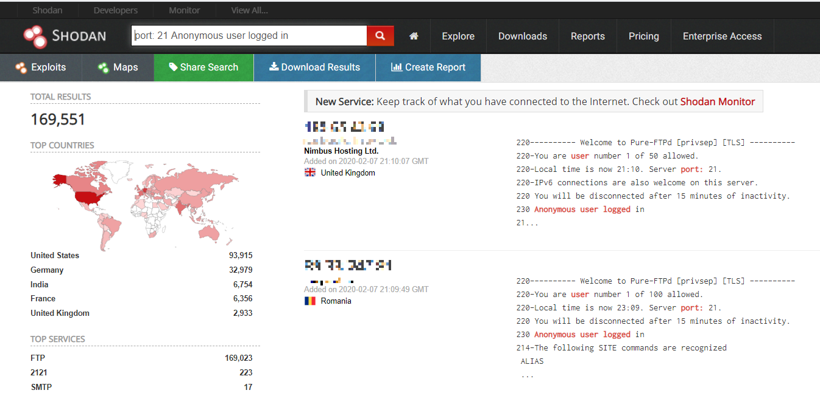

Slide 15
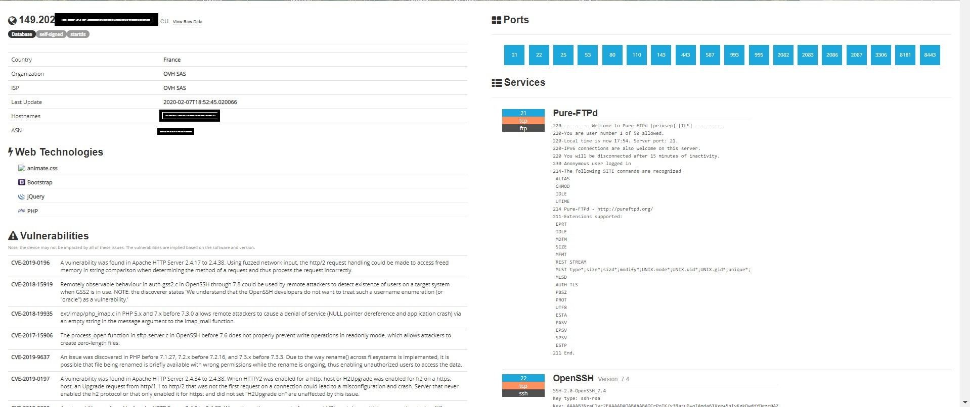

Slide 16
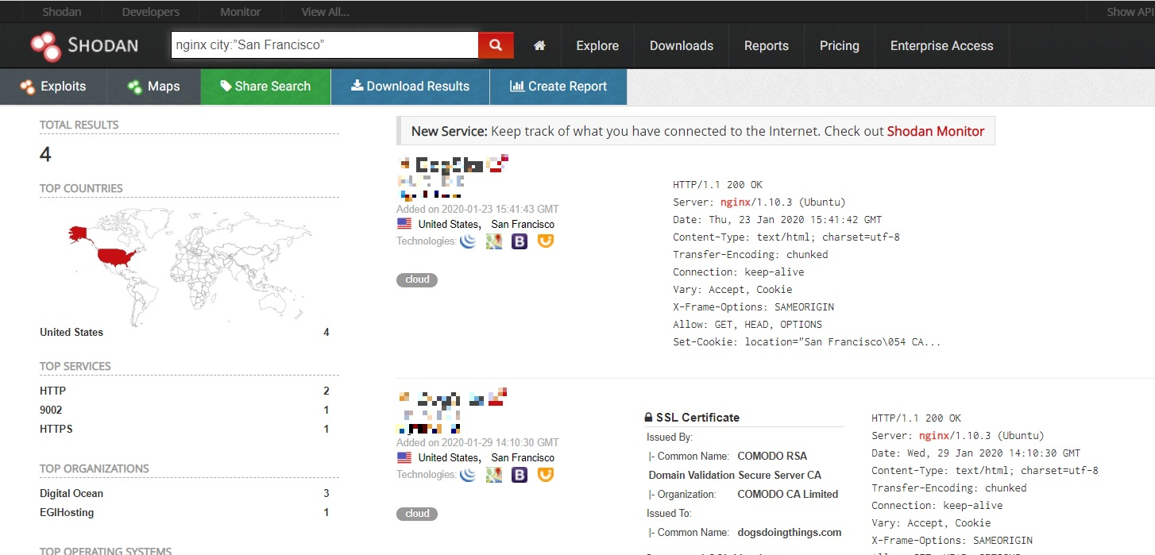

Slide 17
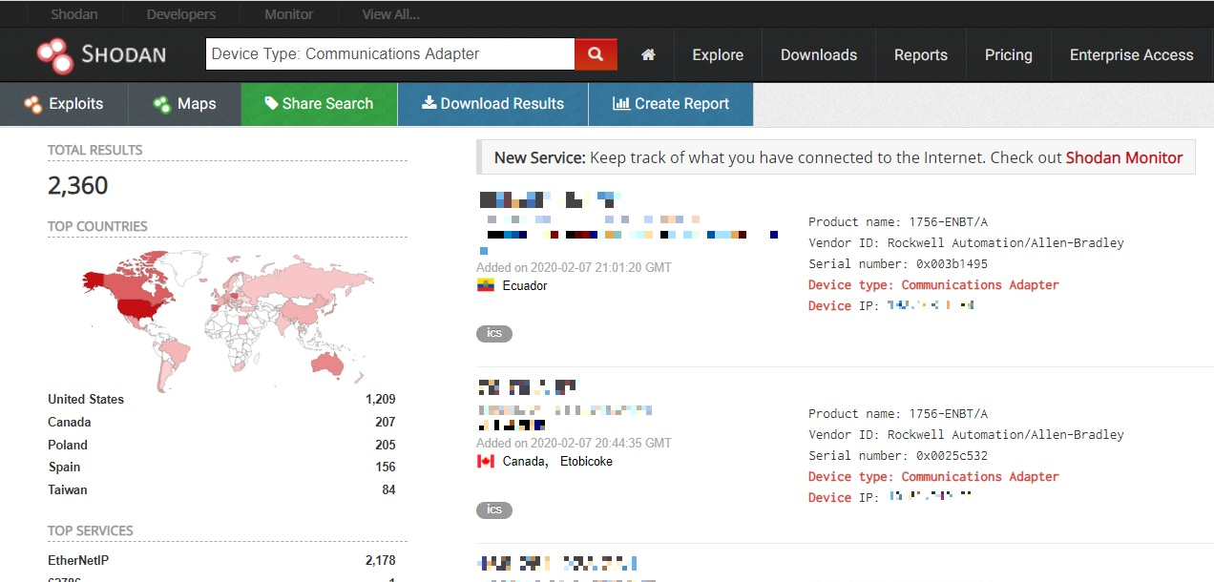

Slide 18
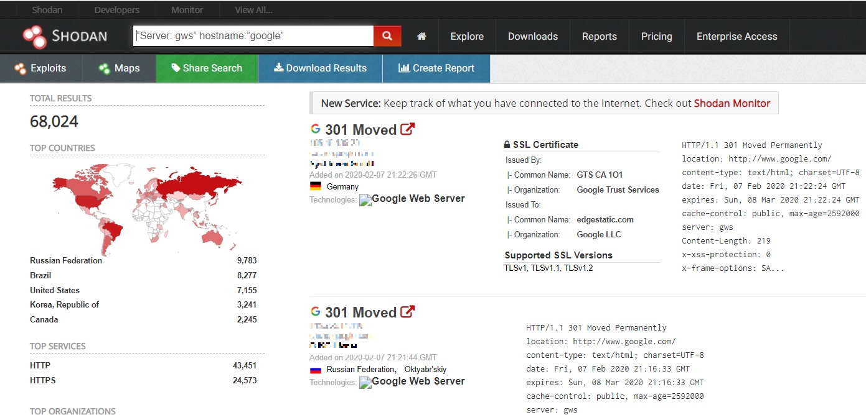

Slide 19
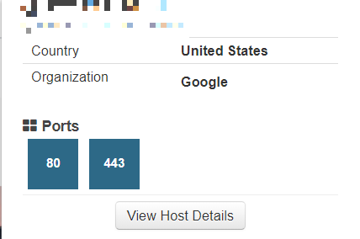
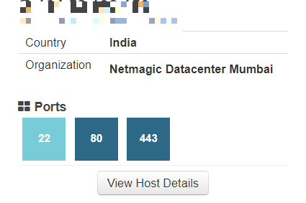
Results : Chrome plugin

Slide 20
CLI zero to one ____________________________________
"easy_install shodan" OR "pip install shodan"
https://github.com/achillean/shodan-python
shodan init <YOUR_API_KEY>
YOUR_API_KEY from
https://www.account.shodan.io
Command line help overview
Shodan –help

Slide 21
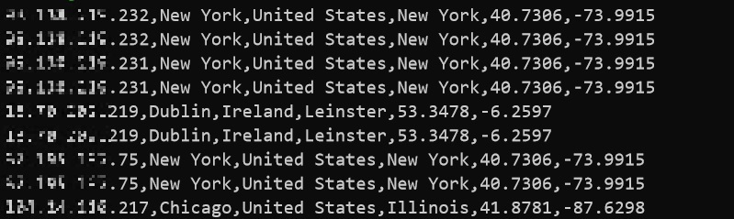
CLI one to two ____________________________________
shodan –help
shodan <command> --help
shodan count <ubuntu 16>
shodan host <ip addr>
shodan myip
shodan search --fields ip_str,port,org <example.com> | awk '{print $1}'|xargs -r -Igeo curl -s http://ip-api.com/json/geo | jq -c [.query,.city,.country,.regionName,.lat,.lon] | tr -d '[ ]"'

Slide 22
Shutting the door on Shodan ______________________________________________
Firewall rules
Security requirements
Integrating security to the device
Securing legacy devices – the “bump-in-the-wire” solution

Slide 23
Notes ______________________________________________
This resource is just an intro to what Shodan is and how to do the basics . You should also take a look at the help pages which are quite good.
Shodan uses its own internally developed port scanner, not Nmap or Zmap.
The system works off of banners, and banners can be modified, spoofed, and faked. What you see is what’s being presented, not necessarily what is real.
You should also check out the blog at https://blog.shodan.io.

Slide 24
References ____________________________________
https://www.shodan.io/
https://help.shodan.io/
https://www.manufacturing.net/industry40/article/13057461/shutting-the-door-on-shodan
https://blog.watchpointdata.com/shodan-demonstrates-why-closing-unused-iot-ports-is-critical-to-cyber-security
https://www.defcon.org/images/defcon-18/dc-18-presentations/Schearer/DEFCON-18-Schearer-SHODAN.pdf

Slide 25
Questions ? ____________________________________

